Slide 1
TensorFHE: Achieving Practical Computation on Encrypted Data Using GPGPU
MICRO’22
0

Slide 2
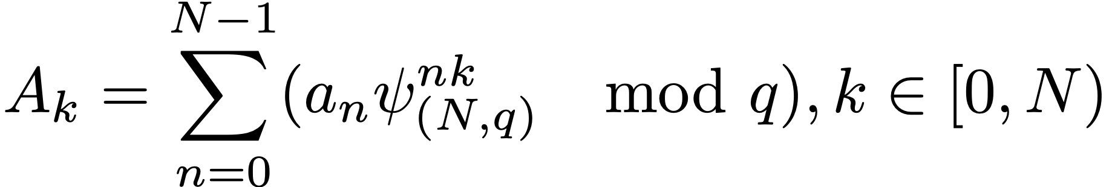
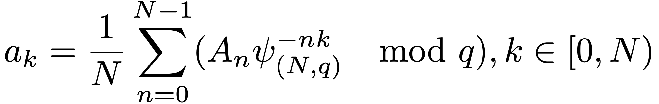
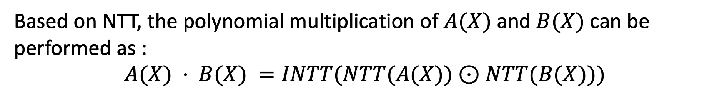
Background
Number Theoretic Transform
NTT:
INTT:
Based on NTT, the polynomial multiplication of $A(X)$and $B(X)$can be performed as :
$$A(X) · B(X) =INTT(NTT(A(X))⊙NTT(B(X)))$$

Slide 3
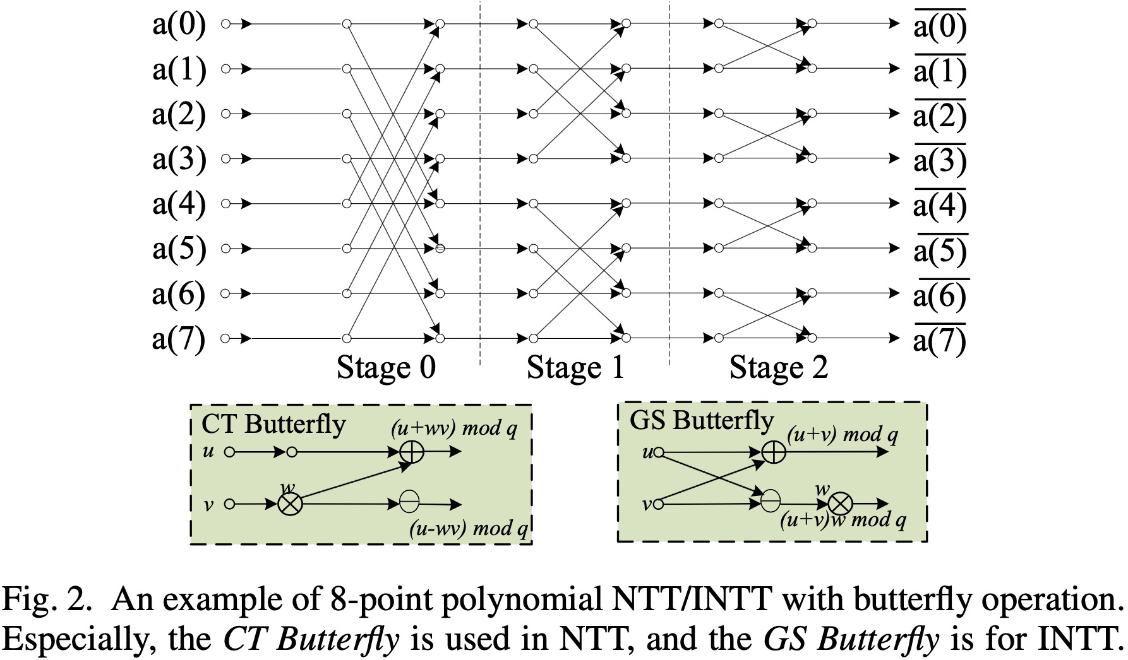
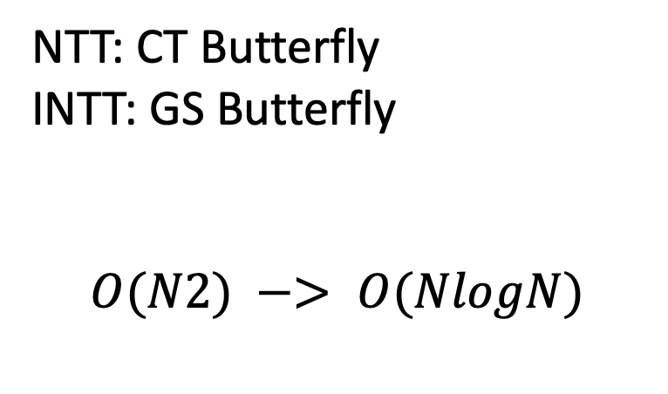
Background
Number Theoretic Transform
NTT: CT Butterfly
INTT: GS Butterfly
$$O(N2) −> O(NlogN)$$

Slide 4
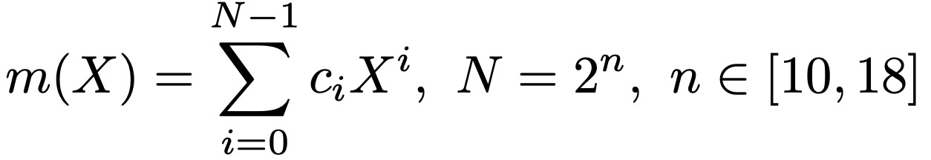
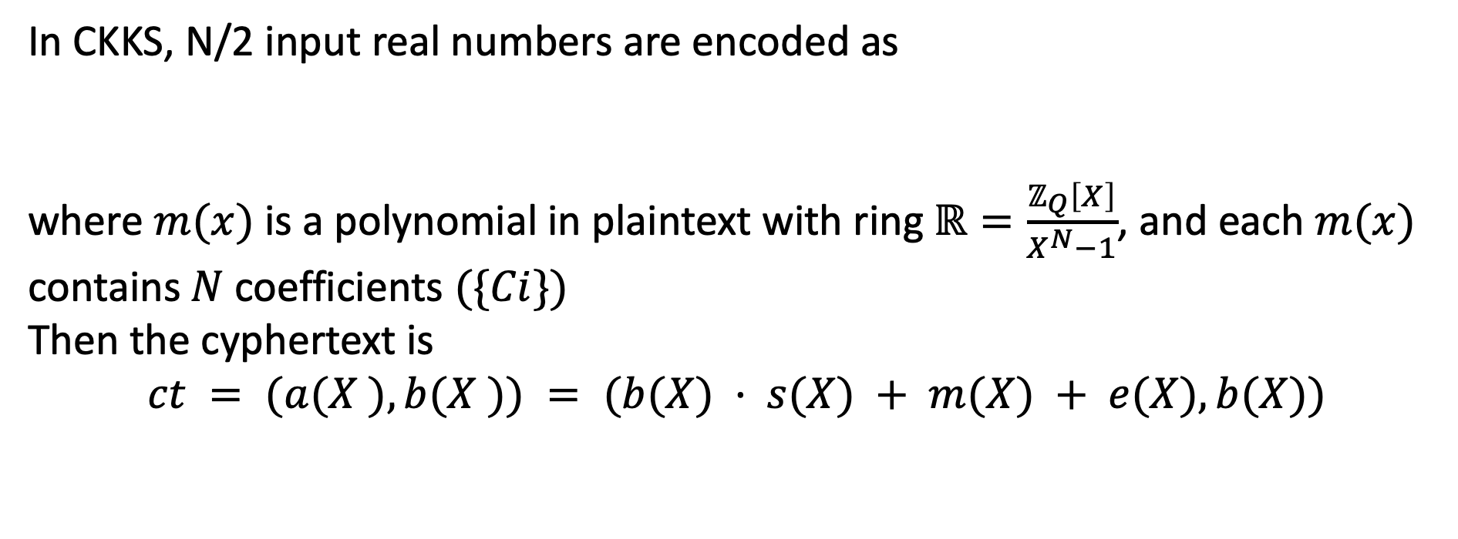
Background
CKKS Scheme
In CKKS, N/2 input real numbers are encoded as
where $m(x)$is a polynomial in plaintext with ring $ℝ=\frac{ℤ_{Q}\left[X\right]}{X^{N}−1}$, and each $m(x)$ contains$N$coefficients $(\{Ci\})$
Then the cyphertext is
$$ct = (a(X ), b(X )) = (b(X) · s(X) + m(X) + e(X), b(X))$$

Slide 5
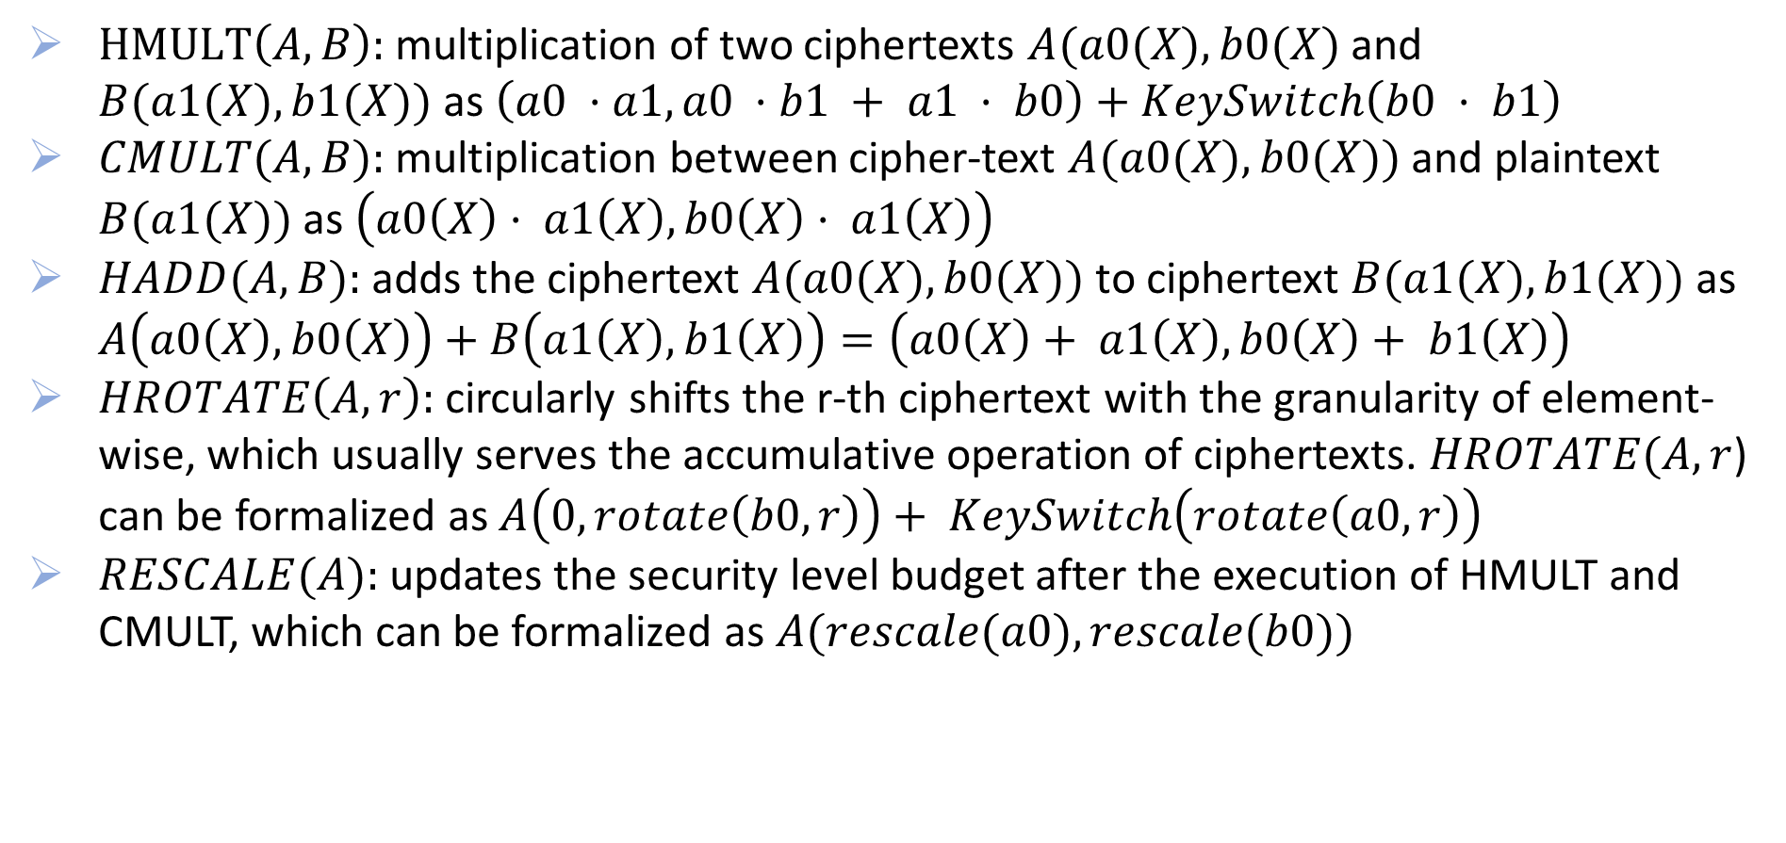
Background
CKKS Scheme
$HMULT\left(A,B\right):$ multiplication of two ciphertexts $A(a0(X),b0(X)$and $B(a1(X),b1(X))$as $\left(a0 ·a1, a0 ·b1 + a1 · b0\right)+KeySwitch\left(b0 · b1\right)$
$CMULT(A,B):$multiplication between cipher-text $A(a0(X),b0(X))$and plaintext $B(a1(X))$as $\left(a0\left(X\right)· a1\left(X\right), b0\left(X\right)· a1\left(X\right)\right)$
$HADD(A,B):$adds the ciphertext $A(a0(X), b0(X))$to ciphertext $B(a1(X), b1(X))$as $A\left(a0\left(X\right), b0\left(X\right)\right)+B\left(a1\left(X\right), b1\left(X\right)\right)=\left(a0\left(X\right)+ a1\left(X\right), b0\left(X\right)+ b1\left(X\right)\right)$
$HROTATE\left(A,r\right):$circularly shifts the r-th ciphertext with the granularity of element-wise, which usually serves the accumulative operation of ciphertexts. $HROTATE(A, r$) can be formalized as $A\left(0, rotate\left(b0, r\right)\right)+ KeySwitch\left(rotate\left(a0, r\right)\right)$
$RESCALE(A):$updates the security level budget after the execution of HMULT and CMULT, which can be formalized as $A(rescale(a0), rescale(b0))$

Slide 6
Background
CKKS Scheme
Residue Number System (RNS): decompose the coefficients, which introduces huge computational overhead, can reduces the complexity of FHE operations
Generalized Key-Switching (GKS):

Slide 7
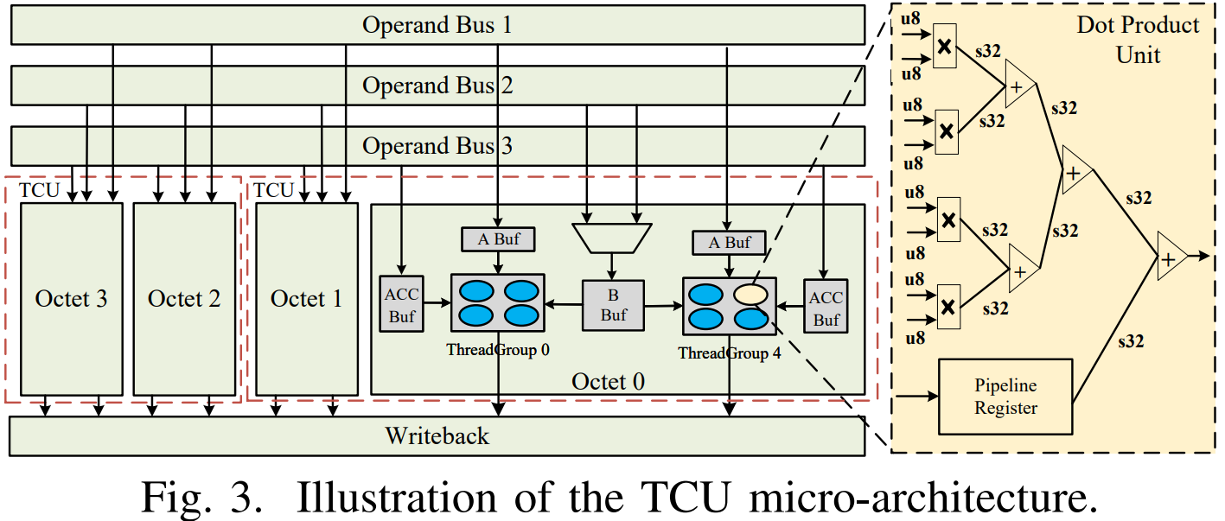
Background
Tensor Core Unit
Each TCU is composed of two octets, while one warp simultaneously uses two TCUs
each thread group owns a specific buffer for the LHS matrix (A Buf) and accumulation results (ACC Buf)
two thread groups in the same octet share one RHS matrix buffer (B Buf) and select its source with a multiplexer

Slide 8
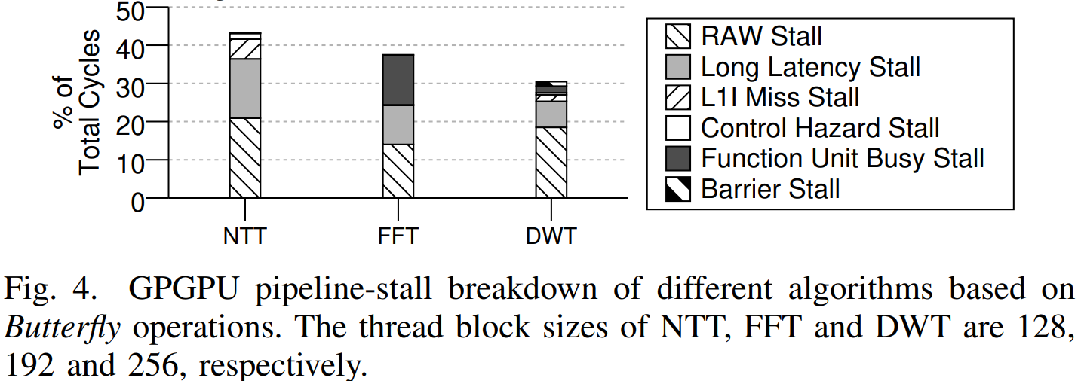
Motivation
Inefficient NTT Computation
NVIDIA 1080Ti GPU
a state-of-the-art NTT
All kernels suffer from the pipeline stall. The proportion of the pipeline stall time is up to 43.2% for NTT.
The most significant reason for the pipeline stall is the Read-After-Write (RAW) issue in all kernels.

Slide 9
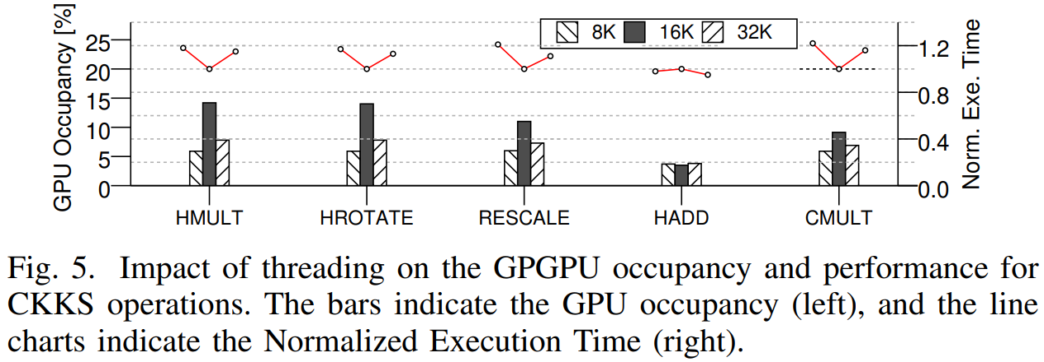
Motivation
Low Computation Resource Utilization
NVIDIA A100 GPGPU
instance of TensorFHE-NT
number of threads from 8196 (8K) to 32768(32K)
From 8K to 16K, the occupancy of all CKKS operations grows.
Increasing to 32K, the GPGPU occupancy of all operations degrades. This is because each thread gets less data and the total number of memory accesses increases, which leads to less efficient bandwidth utilization.
GPGPU occupancy is around 10%!

Slide 10
Motivation
Opportunities
In the state-of-the-art implementation of CKKS, the NTT/INTT kernel is based on the computation for INT32, while the TCUs only support up to INT8.
Besides, GPGPU lacks efficient hardware support for the modulo operation, which also significantly affects the performance of CKKS on GPGPU.

Slide 11
Motivation
Ineffective Usage of Emerging Hardware
Optimize the NTT algorithm to remove the RAW stalls and the excessive modulo operations
Break the CKKS operations into a series of reusable kernels, which balances the bandwidth and computation requirement of each kernel
Optimize the NTT algorithm to apply high-accuracy NTT based on the hardware with limited accuracy support

Slide 12
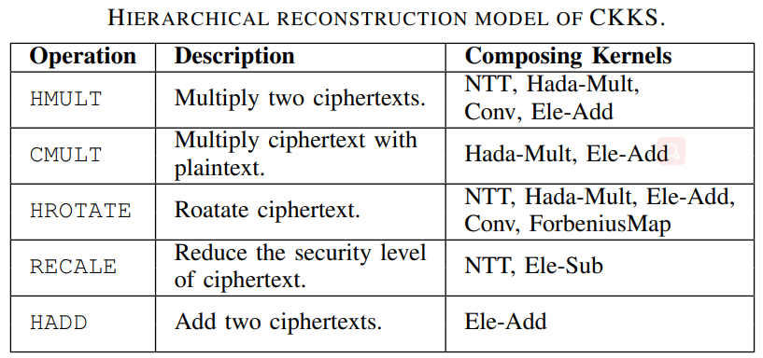
TensorFHE
Hierarchical Reconstruction of CKKS
Each FHE operation can be decomposed into multiple reusable arithmetic kernels.

Slide 13
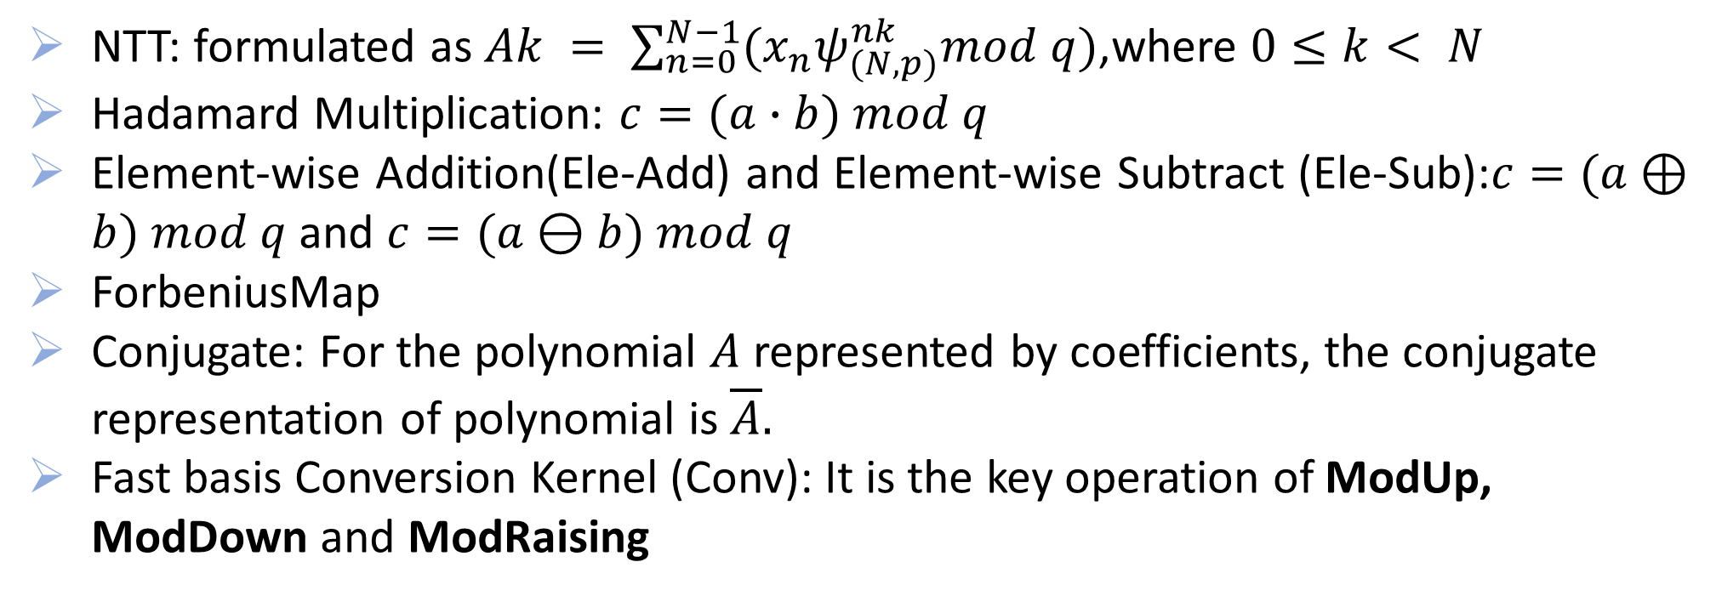
TensorFHE
Hierarchical Reconstruction of CKKS
NTT: formulated as $Ak = \sum_{n=0}^{N−1}{(x_{n}ψ_{(N,p)}^{nk}mod q)\text{,}}$where $0≤k< N$
Hadamard Multiplication: $c=(a∙b) mod q$
Element-wise Addition(Ele-Add) and Element-wise Subtract (Ele-Sub):$c=(a⊕b) mod q$ and $c=(a⊖b) mod q$
ForbeniusMap
Conjugate: For the polynomial $A$ represented by coefficients, the conjugate representation of polynomial is $\overline{A}.$
Fast basis Conversion Kernel (Conv): It is the key operation of ModUp, ModDown and ModRaising

Slide 14
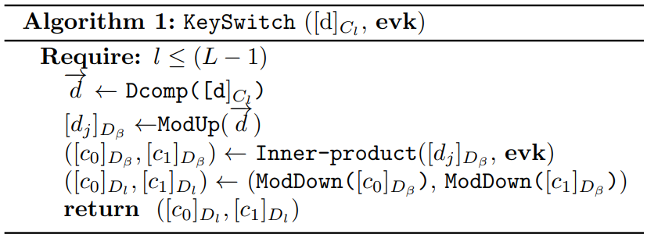
TensorFHE
Hierarchical Reconstruction of CKKS
keySwitch: ModUp, the ModDown, the Dcomp and the Inner-product
ModUp and the ModDown can be composed by multiple NTTs and Convs
Dcomp can be implemented with a minor modified Conv.
Inner-product is implemented with multiple Hada-Mults and Ele-Adds

Slide 15
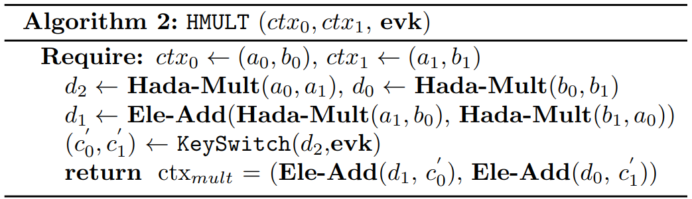
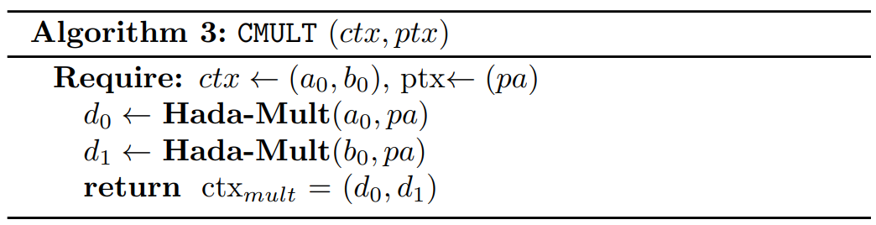
TensorFHE
Hierarchical Reconstruction of CKKS
HMULT and CMULT

Slide 16
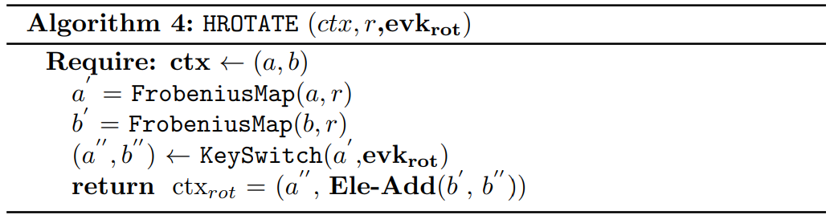
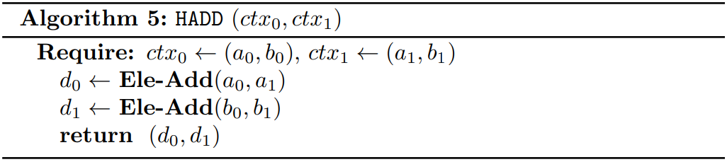
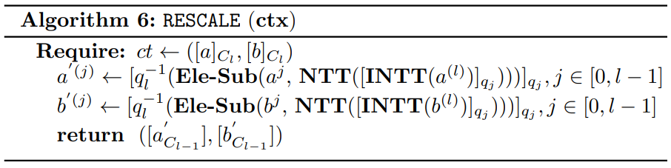
TensorFHE
Hierarchical Reconstruction of CKKS
HROTATE: ForbeniusMap and Ele-Add, Keyswitch
HADD: Ele-Add
RESCALE:NTT and Ele-Sub

Slide 17
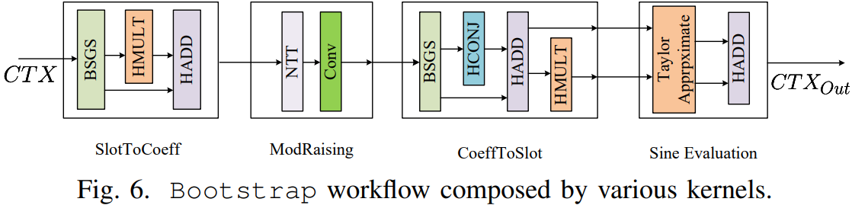
TensorFHE
Hierarchical Reconstruction of CKKS
Bootstrap

Slide 18
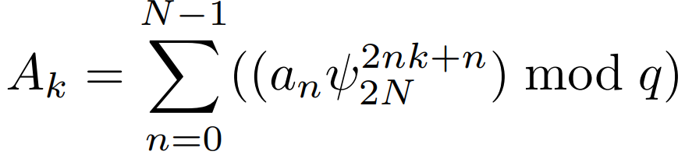
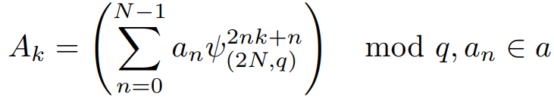
TensorFHE
NTT Optimization for CUDA Core
RAW stall
lack of modular arithmetic
convert the NTT from the butterfly algorithm to matrix-vector multiplication as

Slide 19
TensorFHE
NTT Optimization for CUDA Core
Adopt the Cooley-Tukey Recursive algorithm , which transforms the input vector (a) to an input matrix (aN1×N2 , where N = N1×N2). The scale of the twiddle factor matrix is also reduced to N1 × N1

Slide 20
TensorFHE
NTT Optimization for CUDA Core
Data Reuse: twiddle factor matrix can be pre-computed in the initialization and reused
Hardware Efficiency: matrix-vector multiplication has good memory locality and can be easily paralleled
Module Reduction: Only one modulo operation is required for each Ak and saves time due to modulo reduction

Slide 21
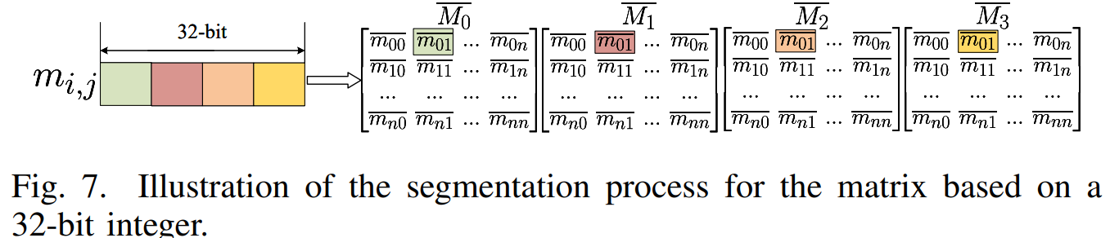
TensorFHE
NTT Optimization for Tensor Core
segment every consecutive 8-bits into an 8-bit integer
each 8-bit integer is distributed to the corresponding place of mi,j in the segmented matrices

Slide 22
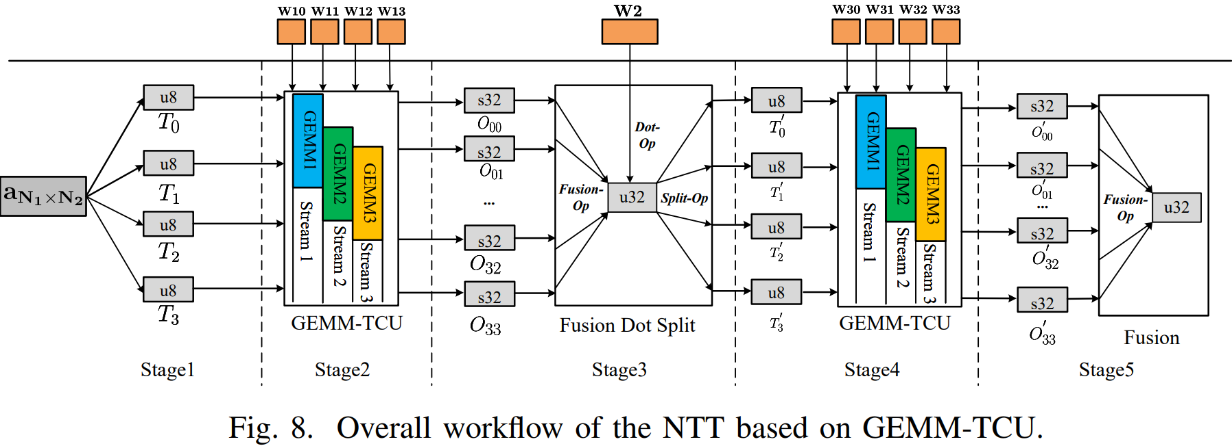
TensorFHE
NTT Optimization for Tensor Core
Stage1-Input Matrix Segmentation: segment the input aN1×N2 into four small-scale matrices (denoted as T0 to T3)

Slide 23

TensorFHE
NTT Optimization for Tensor Core
Stage2-TCU GEMM for aN1×N2 × W1: Based on T0 to T3, we fulfill the aN1×N2 × W1 on the TCUs.
where W1i indicates the segmentation matrices of W1

Slide 24
TensorFHE
NTT Optimization for Tensor Core
Stage3-Fusion and GEMM with W2: The output matrices of Stage2 (Oij ) are firstly fused as one by using the Booth multiplication algorithm, which treats the corresponding elements from every matrix as partial accumulations

Slide 25
TensorFHE
NTT Optimization for Tensor Core
Stage4-TCU GEMM with W3: Similar to Stage2, we fulfill the O’ij = T’j × W3i , i, j ∈ [0, 3] on the TCUs.

Slide 26
TensorFHE
NTT Optimization for Tensor Core
Stage5-Fusion and Output: Similar to Stage 3, the output matrices of Stage4 (O0 i j) are fused into one u32 matrix, which is stored in row-major, using the Booth multiplication algorithm. Then, the fused matrix is moduloed element-wise by q with output as the NTT result.

Slide 27
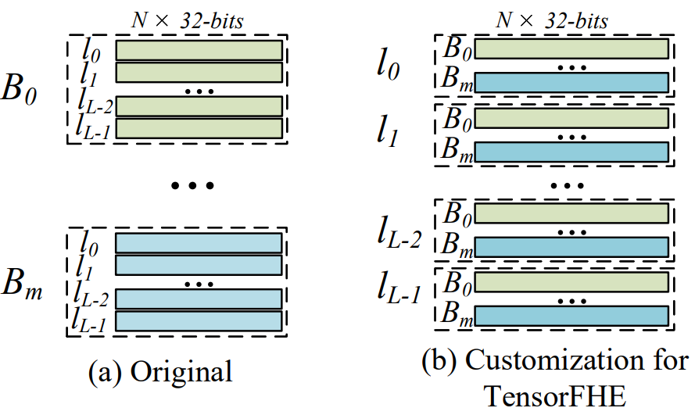
TensorFHE
Operation-Level Batching
With operation-level batching, all running kernels process the data with the same L, since they can reuse the same twiddle factor matrix for NTT.

Slide 28
TensorFHE
TensorFHE Implementation Batching
API Layer runs on the CPU, which collects and decomposes the requests for FHE operations from the user applications.
The decomposed requests are in the manner of workflow, which consists of the basic kernels.
The API layer automatically generates the best batch size for the different involved kernels according to the hardware resources.
The API layer sequentially invokes the kernels in the workflow with proper batch size.
Kernel Layer consists of various arithmetic kernels that run on the GPGPU.
The kernel layer receives the invoking request from the API layer and returns the results of the requested operations.

Slide 29
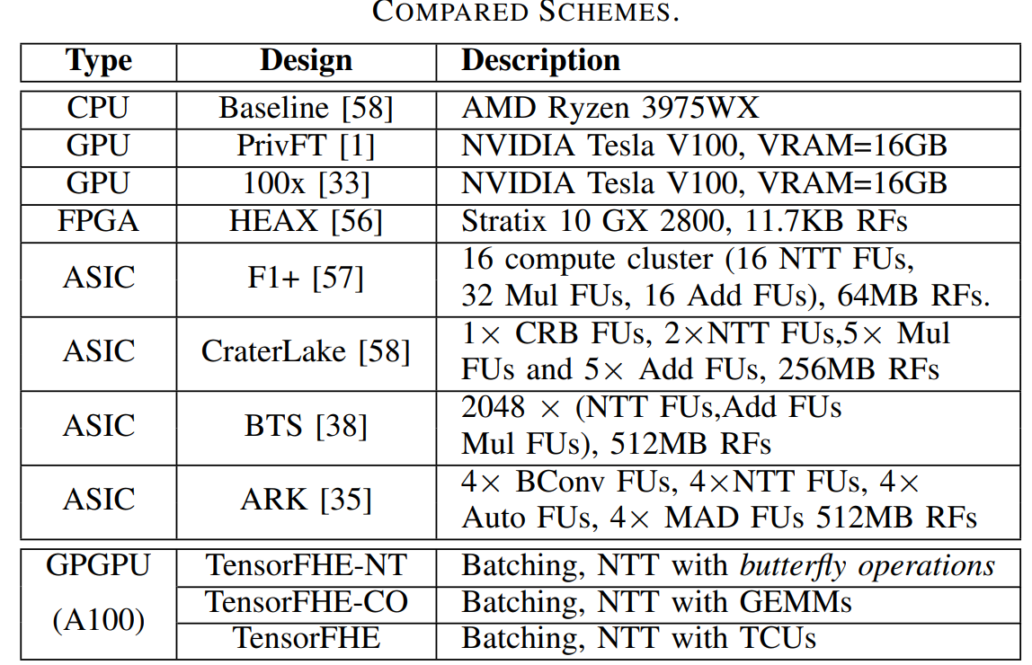
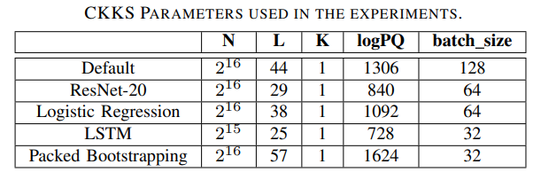
Methodology
env: CUDA 11.0 and PyTorch 1.7

Slide 30
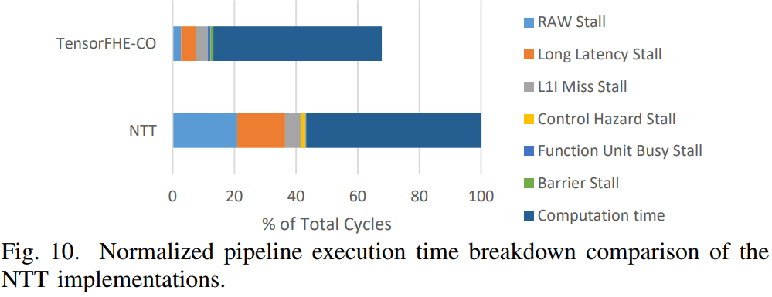
RESULTS
The effectiveness of NTT optimization

Slide 31
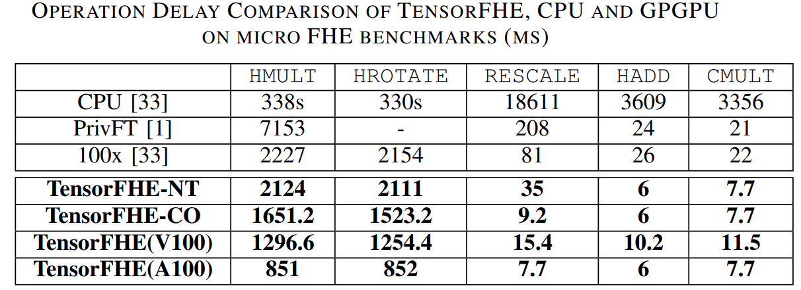
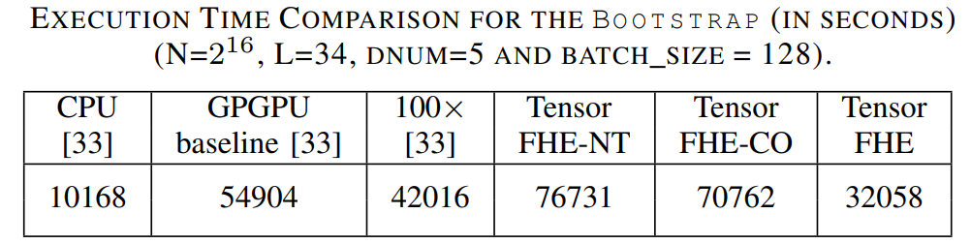
RESULTS
TensorFHE vs. CPU, GPGPU and FPGA
Performance:
Execution Time Breakdown:

Slide 32
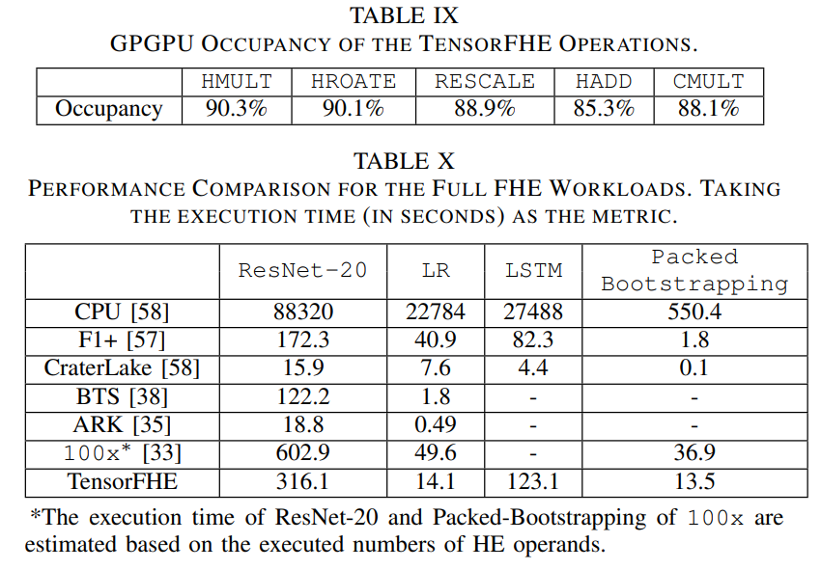
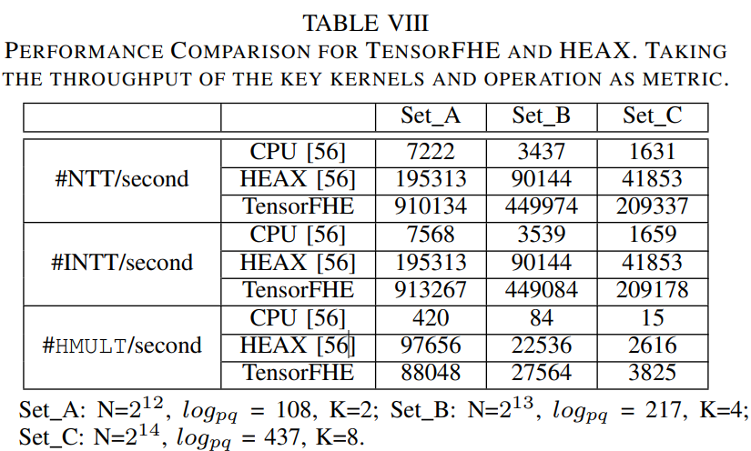
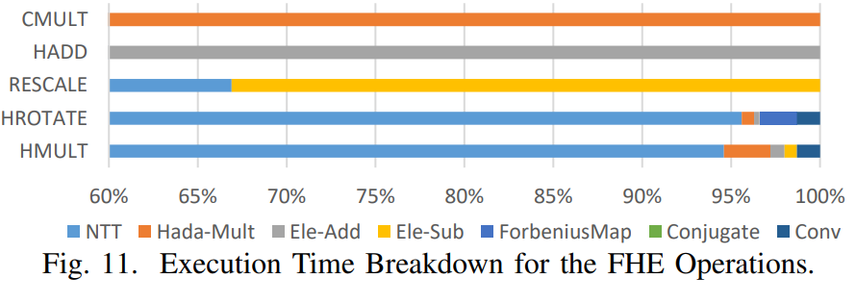
RESULTS
Evaluation with Real Workload
Performance:
Execution Time Breakdown:

Slide 33
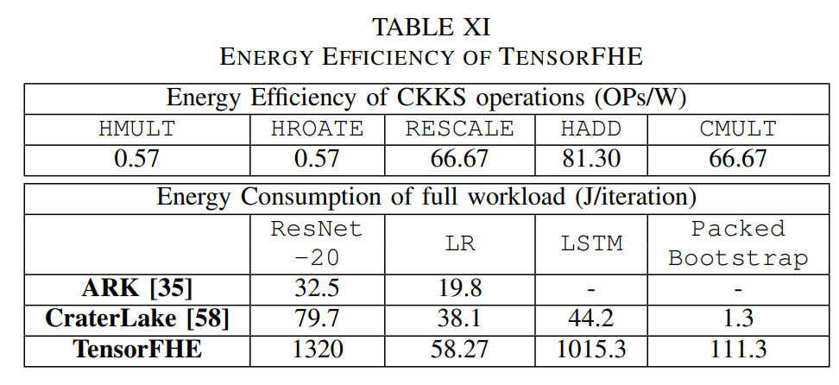
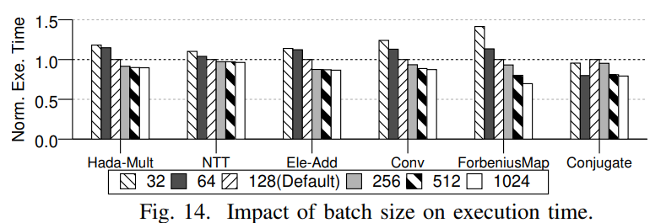
RESULTS
Energy
Sensitivity Study to the Batch Size

Slide 34
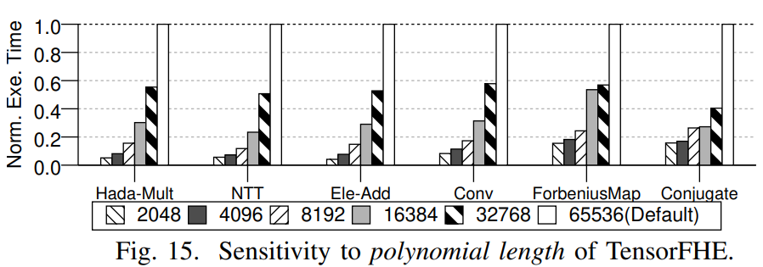
RESULTS
Sensitivity Study to the Polynomial Length

